Slide 1
Please pull out the following BEFORE class starts:
Interactive Notebooks (INB)
The Starter:
No Starter Today, be ready to begin at the bell.
Fill in your Table of Contents:
7.1 pg. 96 Writing Equations
7.2 pg. 98 Solving Equations with Add or Subt
7.3 pg. 100 Solving Equations with Mult. or Div.
7.4 pg. 102 Solving Equations in Two Variables
7.5a pg. 104 Writing Inequalities
7.5b pg. 106 Graphing Inequalities

Slide 2
Take a Ride:
Turn in your homework (7.5a Writing Inequalities)
Pick up a ClearBoard, marker and eraser
Pick up the BUFF Notes
Pick up the WHITE homework WS
Make sure you have a pencil.
Once you get back to your seat: (10 sec!)
Clear your desks: Keep out your BUFF notes, and pencil. Everything else, off your desk! ☺

Slide 3
Graphing Inequalities
Chapter 7.5b – Lesson
I can use a number line to graph the solution set of inequalities and use inequalities to represent real-life situations.

Slide 4
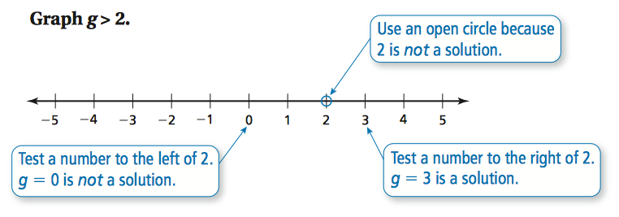

Slide 5
7.5b
ClearBoards!
1. a < 4
2. f ≤ 7
3. n > 0

Slide 6
7.5b
ClearBoards!
4. p ≥ –3
5. g > –5
6. m ≤ 1

Slide 7
7.5b
ClearBoards!
7. h < –6
8. x ≥ 8
9. y > –2

Slide 8
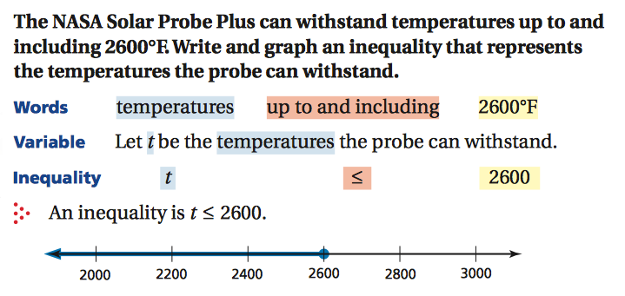

Slide 9
7.5b
ClearBoards!
10.
11.

Slide 10
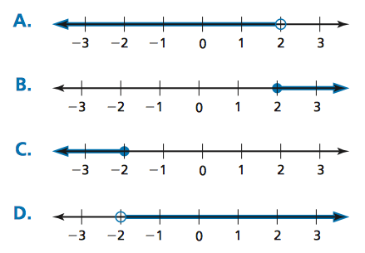
Exit Ticket Time! ☺

Slide 11
Exit Ticket Time! ☺
✓
B
A
D
C

Slide 12
Take a Ride:
Put away all your materials.
Notes & Homework in your math folder
INB back in your cubby
Put away your ClearBoard materials
Turn in your Exit Ticket to the basket on the purple counter
Give your red pen to Ms. Hatch
Make sure your desk area is CLEAN!

