Slide 1
Please pull out the following BEFORE class starts:
Interactive Notebooks (INB)
Your homework worksheet (7.3 Solving Equations WS)
The Starter:
No Starter Today, be ready to begin at the bell.
Take a Ride:
Turn in your homework (7.3 Solving Equations WS)
Pick up the GOLD Notes
Pick up a WHITE Homework WS
Make sure you have your INB and a pencil.

Slide 2
Once you get back to your seat: (30 sec!)
Fill in your Table of Contents:
7.1 pg. 96 Writing Equations
7.2 pg. 98 Solving Equations with Add or Subt
7.3 pg. 100 Solving Equations with Mult. or Div.
7.4 pg. 102 Solving Equations in Two Variables
Clear your desks: Keep out your GOLD notes, and pencil. Everything else, off your desk! ☺

Slide 3
Solving Equations in two variables
Chapter 7.4 – Lesson
I can identify independent and dependent variables and can write equations in two variables. I can use tables and graphs to analyze the relationship between two variables.

Slide 5
7.4
Pg. 103

Slide 7
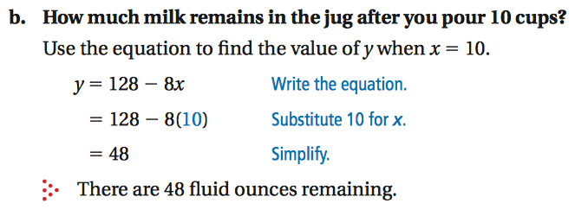

Slide 8
7.4
Pg. 103

Slide 9
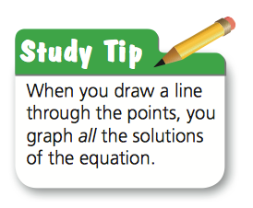
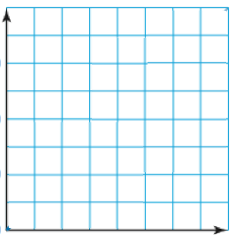

Slide 11
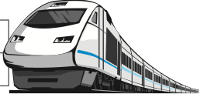

Slide 12
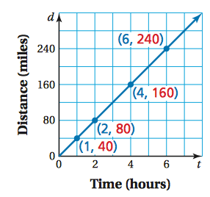

Slide 13
7.4
Pg. 103
Independent Variable (# of hours, h) | Equation: ______________________ | Dependent Variable (total cost, c)
2
4

Slide 14
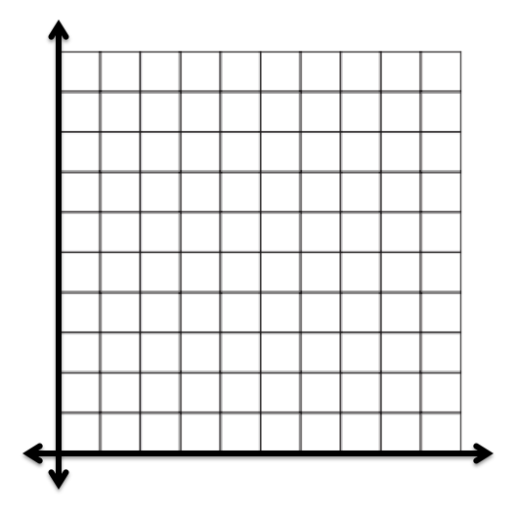
7.4
Pg. 103
h | c
2 | 41
4 | 57
100
90
80
70
60
50
40
30
20
10
Cost (dollars)
1 2 3 4 5 6 7 8 9 10
Time (hours)

Slide 15
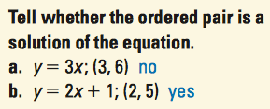
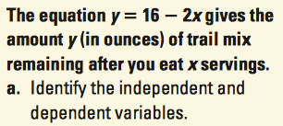
Exit Ticket Time! ☺
(front)
(back)
2)

Slide 16
Exit Ticket Time! ☺
✓
(front)
(back)
2)
a) Not a sol’n
b) Is a sol’n
a) Ind: x, servings
b) Dep: y, trail mix remaining
b) 4 oz.

Slide 17
Take a Ride:
Put away all your materials.
Notes and homework WS in your math folder
INB back in your cubby
Turn in your Exit Ticket to the basket on the purple counter
Give your red pen to Ms. Hatch
Make sure your desk area is CLEAN!

